Slide 1
*Data tour
Azure Data Processing Whirlwind

Slide 2
Elastacloud; data on Azure experts
Azure MVP for 4 years; Microsoft Regional Director;
Founder UKAzure User Group
Founder IoT Innovators
Andy Cross & Richard Conway, Founders and Directors of Elastacloud
Leading UK Data and Azure Consultancy
Based in London
Azure Gold Partner, Cloud Platform and Data Analytics

Slide 3










customers

Slide 4
Azurecraft
Register for Day 1: Get the Latest on Azure from Experts in the Community
https://www.microsoftevents.com/profile/form/index.cfm?PKformID=0x183009a05b
Register for Day 2: Get Hands-On with the Latest Tech and Games. Join the Community Hackathon!
https://www.microsoftevents.com/profile/form/index.cfm?PKformID=0x179399b15c

Slide 5
People, Tools and Processes
A view on technology CHOICE

Slide 6
Choose based on strength
Tool choice has never been stronger
Buy vs Build largely resolved
In the favour of “buying” a “free” OSS toolset
Coupled with “managed” via distributor or vendor support
Integrated and oriented by an SI
Choose your platform based on reusing existing skills.

Slide 7
Convergence around SQL
SQL as a language is very pervasive

Slide 8
The Challises
JVM:
Hadoop Stack
Including Hive, PIG etc
Spark Stack
Including Spark-SQL
.NET and C#:
Azure Data Lake Analytics
Including U-SQL
Pure SQL:
Azure SQL Data Warehouse
Build your own via Azure Batch
MatLab
Custom Runtimes
Build your own via Azure Virtual Machines
Any Windows Stack
Any Linux Stack

Slide 9
Platform As A Service is where you want to be
Whilest we’re considering this
Responsibilities for:
Configuration
Uptime
Maintenance
Version Increments
Supported tooling for
Decentralized configuration
Remote execution
SaaS
PaaS
IaaS

Slide 10
Architecture patterns
Lambda; bulk ingest; micro-batch

Slide 11
Architecture types defined by data
Defining:
Individual Messages
Typically small
Typically time sensitive
Small collections of Messages
Grouped by a time slice
Large collections of Messages
Possibly not time structured at source

Slide 12
A lambda architecture
A modern scalable

Slide 13





Real Time Messages
Service Fabric
Event Hub
Operational Store
Stream Analytics
Power BI

Slide 14




Batch Runtime
Orchestrated by Azure Data Factory
Azure Data Lake Analytics
Operational Store
Service Fabric
Azure Data Lake Store
Azure HDInsight
Power BI

Slide 15

Componentized
Achieving pan-framework with analytics that are
Orchestrated by Azure Data Factory

Slide 16
A statement on Provenance

Slide 17
Logs Pivoted
Typical logs
Event driven
Centralized (maybe a decentralized backup?)
Time ordered
Finding why an output file has an incorrect value is hard
Instead store metadata 1:1 on files

Slide 18
Consistency of tools

Slide 19
Provision
Azure Portal
Azure CLI
Azure Powershell
Visual Studio Integration

Slide 20
A light touch of Tech
Examples of Runtimes in USQL

Slide 21
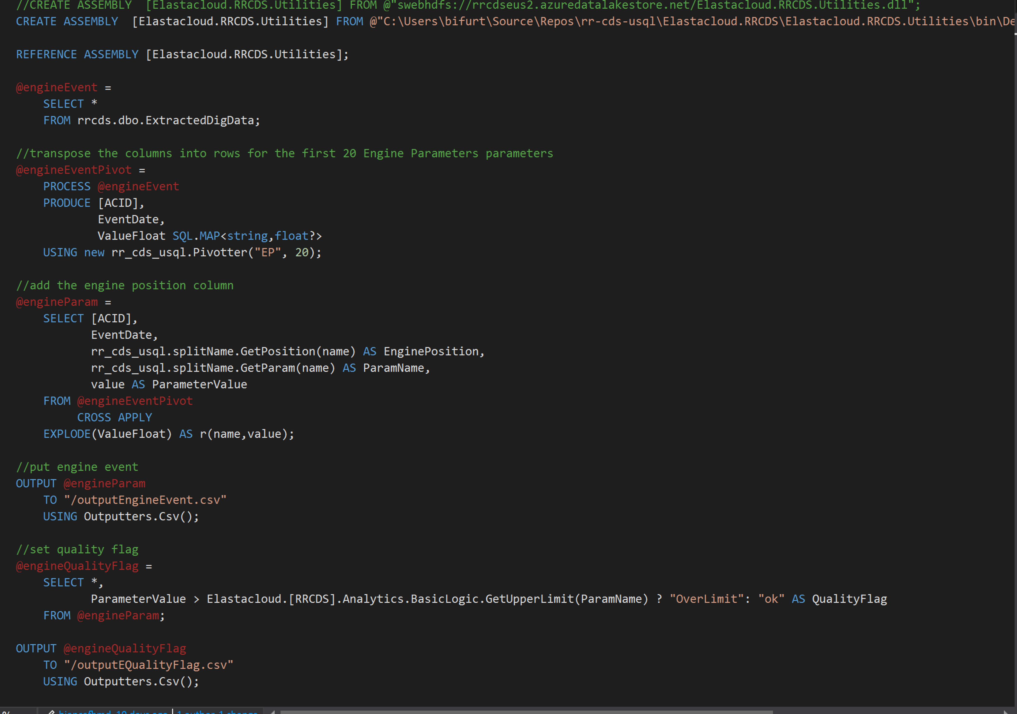

Slide 22
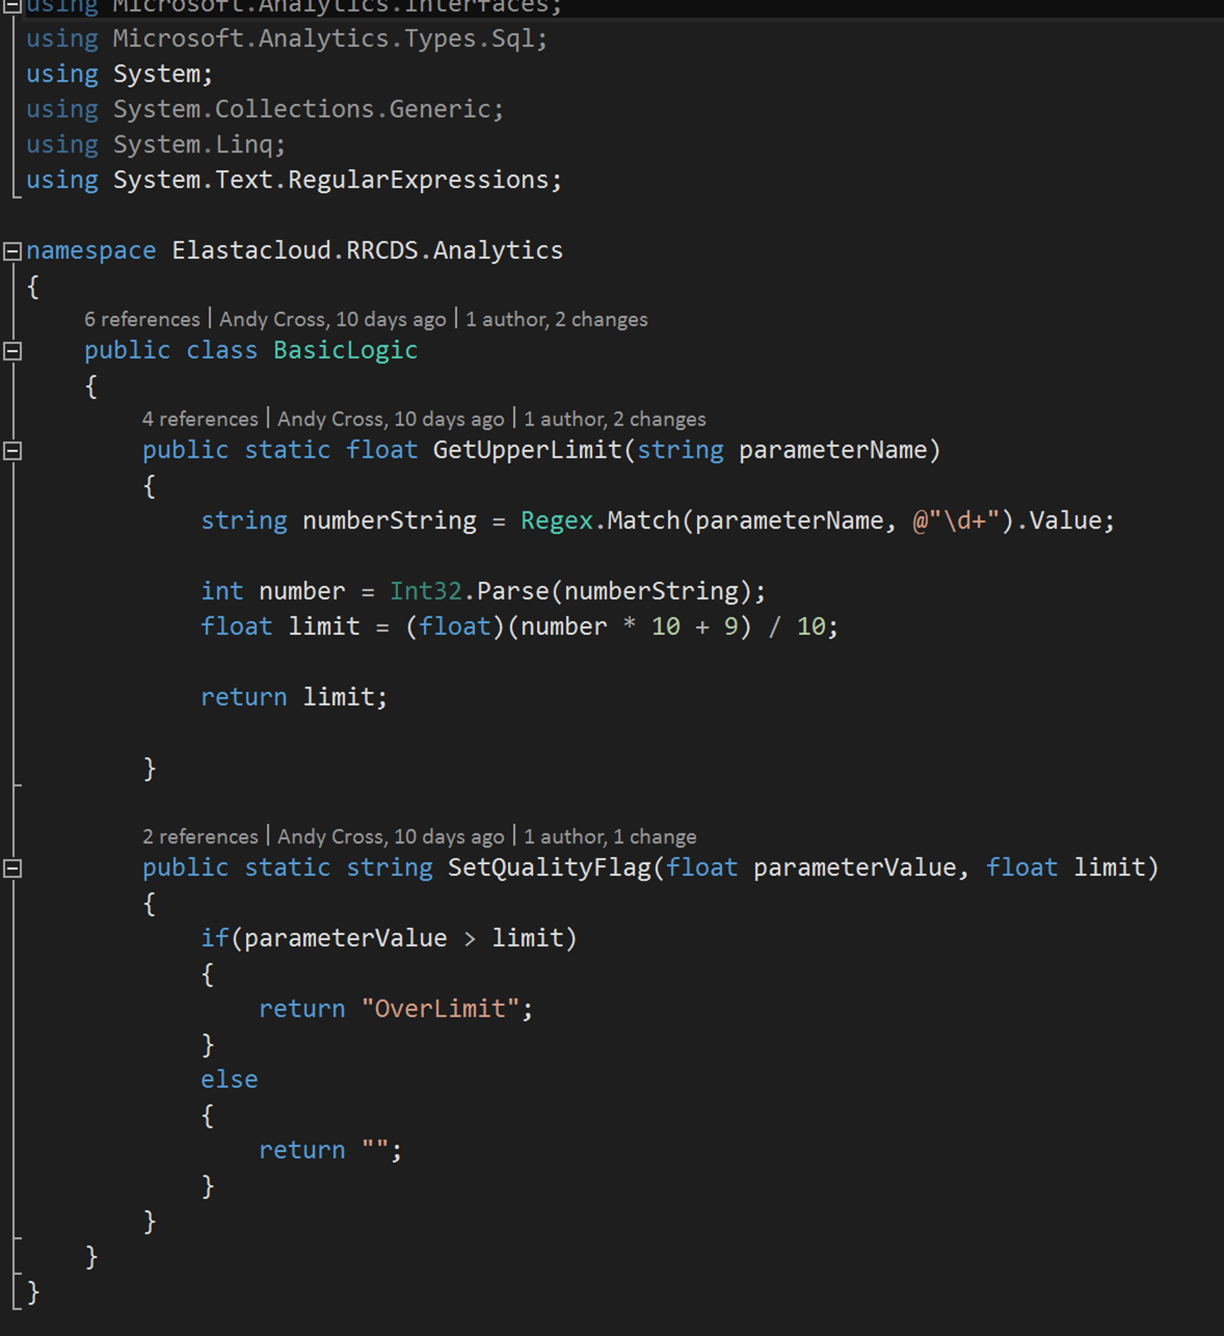

Slide 23
Modern Visualization Stack

Slide 24
Business Intelligence for Everyone
3rd wave End user BI
Everyone
2nd wave Self-service BI
Analyst to end user
1st wave Technical BI
IT to end user
Notes:
We’re moving into an age where the analyst and IT user who used to dominate and control BI had to translate requirements and then build a BI reporting system
This starts off at the first wave – which is the technical user
The second wave a more advanced user that can self-serve BI and the last wave is everyone else that will consume the reports
In this session we’re concerned about the middle user

Slide 25
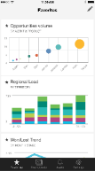
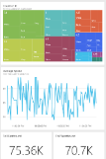
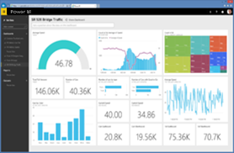
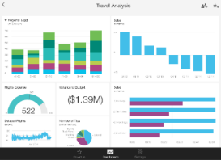
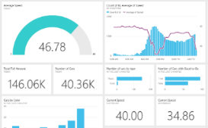
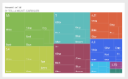


Interrogate a variety of data sources
Data sources
Power BI service
Content packs
Natural language query
Sharing & collaboration
SaaS solutions
E.g. Marketo, Salesforce, GitHub, Google analytics
Live dashboards
On-premises data
E.g. Analysis Services
Visualizations
Organizational content packs Corporate data sources, or external data services
Azure services
E.g. Azure SQL, Stream Analytics
Reports
01001
10101
Excel files
Workbook data or data models
Datasets
Power BI Desktop files
Related data from files, databases, Azure, and other sources
Data refresh

Slide 26

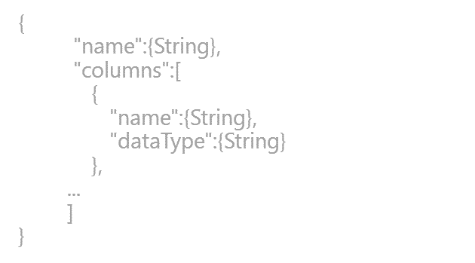
Explore Using Desktop Files
SaaS solutions
E.g. Marketo, Salesforce, GitHub, Google analytics
Content packs
Natural language query
Sharing & collaboration
On-premises data
E.g. Analysis Services
Live dashboards
Organizational content packs Corporate data sources, or external data services
Visualizations
Azure services
E.g. Azure SQL, Stream Analytics
Excel files
Workbook data and data models
Reports
01001
10101
Power BI Desktop files
Related data from files, databases, Azure, and other sources
Datasets
0110001
00010110
Data refresh
Power BI Desktop
Power BI REST API
Prepare
Explore
Report
Share
Notes:
Let’s walk through an overview of how Power BI works.
1. The Power BI service, sometimes referred to as powerbi.com, is what allows you to:
Create beautiful visualizations to tell compelling data stories
Build rich, live dashboards that turn BI into business insights
Create reports & datasets from which you can create visualizations and dashboards
Enjoy the benefits of up-to-date data with real-time, automatic and scheduled refreshes
Share dashboards easily with other people in your organization
Ask questions of data in plain English with Natural Language Query
Stay connected to your data all the time with mobile applications
2. Power BI connects to a variety of data sources. These range across both cloud and on-premises sources, and include:
A variety of popular SaaS solutions, such as Marketo, Salesforce, GitHub, Dynamics CRM, Zendesk, and several others
On-premises databases – Power BI offers live connectivity to SQL Server Analysis Services, which we’ll cover in more detail later. And using a gateway solution, Power BI can connect to other database solutions.
Custom data sources – Power BI can connect to any data source you need it to thanks to its extensibility via REST APIs. This includes both proprietary corporate data sources, as well as external data services. For example, if you are a SaaS solution provider, you can work with Microsoft to connect your solution to Power BI.
Other Azure services – Power BI integrates tightly with SQL Azure and Stream Analytics, and will be integrating closely with more Azure services over time
Power BI Desktop and Excel files – Excel workbooks can be directly connected to Power BI.com, or may be used with Power BI Desktop. Power BI Desktop is a companion application to the Power BI service – it is a desktop tool that supports data analysis and reporting. Like Excel files, Power BI Desktop files may be uploaded to the Power BI service.
Business user
Import data from SaaS sources, and work with dashboards and reports
Business analyst
Import, reshape and model data
Create compelling reports and visualizations
Create content packs to share insights
BI professional
Connect to live Azure data services
Connect to on-premises Analysis Services databases
Empower colleagues to create their own reports
Developer
Integrate applications with Power BI
Create real-time dashboards

Slide 27
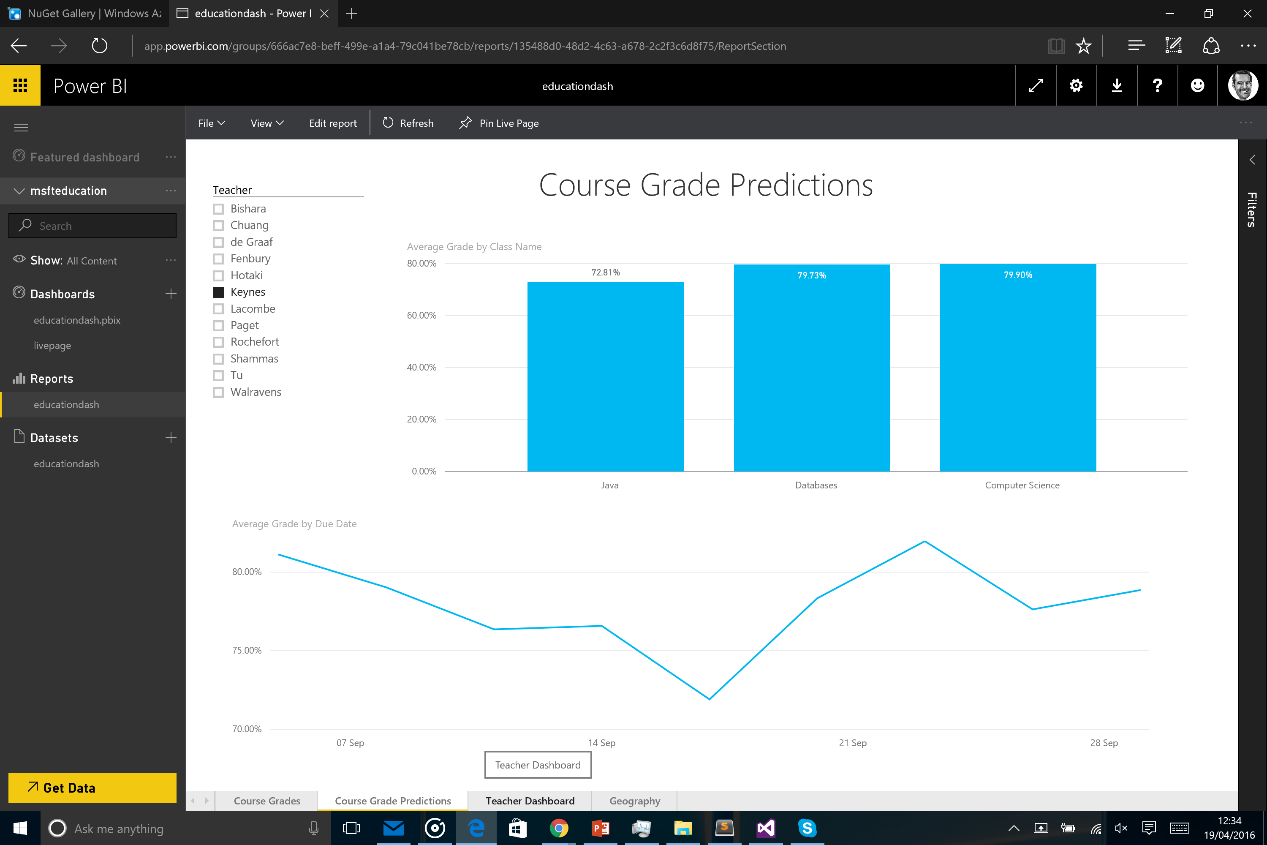

Slide 28
Deeper dive; Azure technologies for data
Handover to Richard Conway

